Slide 1
Be There or Be (Chi)-Square!

Slide 2

What is a Chi-Square?
Statistic for categorical data
Similar in concept to t-test
$χ^{2}$

Slide 3
Types of Chi-Squares
Independent (this lesson!)
Compare categories
Like the independent t
Goodness of Fit
Compare your data to a population
Like the single-sample t
McNemar
Compare changes over time
Like the dependent t

Slide 4
Independent Chi-Square

Slide 5
Compare Observed to Expected
Observed – your actual data
Expected – if there was NO RELATIONSHIP between your variables
Chi-Square value is the difference between observed and expected frequency counts

Slide 6
Assumptions
Observations are independent
People or objects are only in 1 group
At least 5 expected per cell

Slide 7
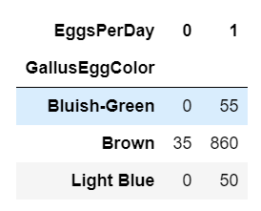
Egg-xample Time!
Do chickens’ egg colors influence whether they lay an egg daily?
Null hypothesis:
There is no relationship between the egg color and whether an egg has been laid.
Alternative hypothesis:
There is a relationship between egg color and whether an egg has been laid

